Slide 1
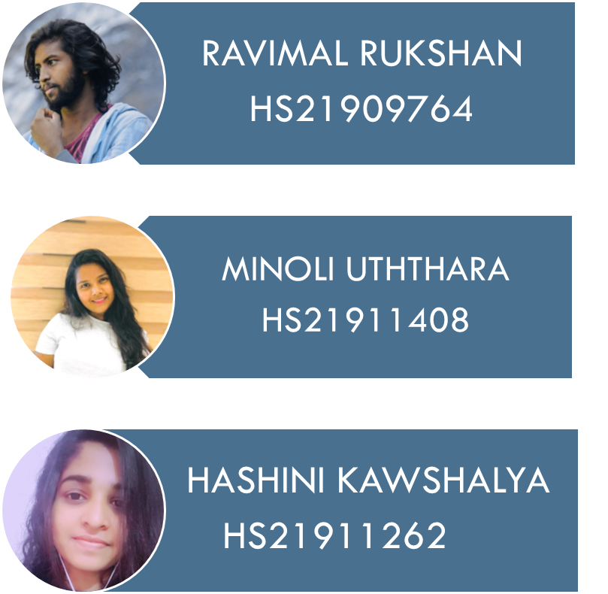
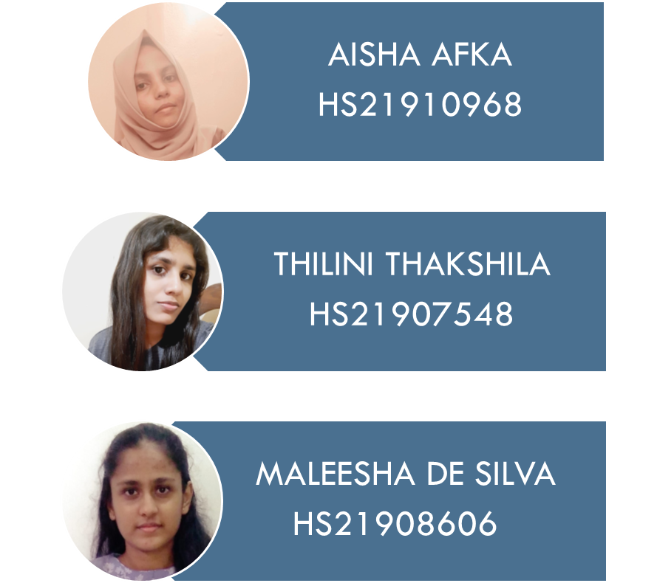
GROUP 07 – TEAM MEMEBERS

Slide 2
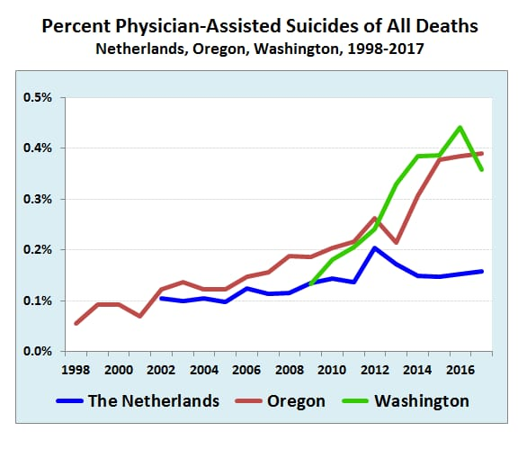
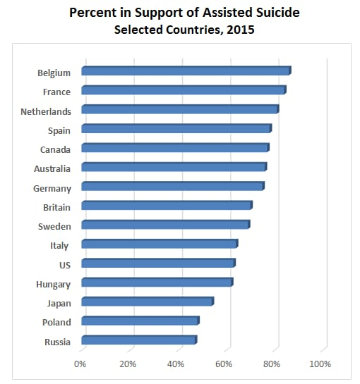

Slide 3
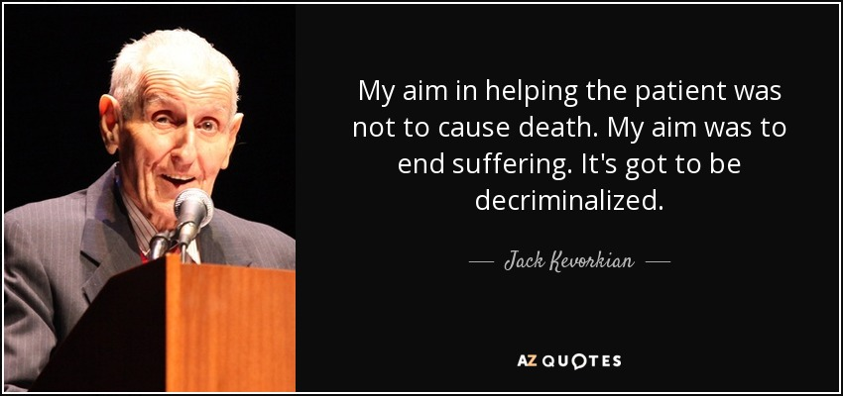
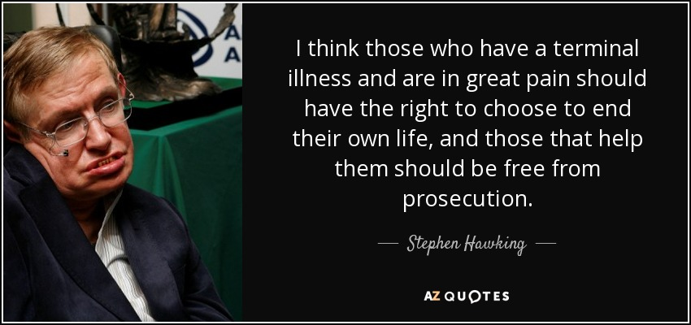
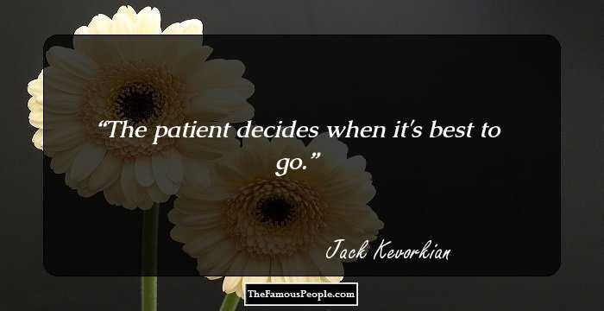
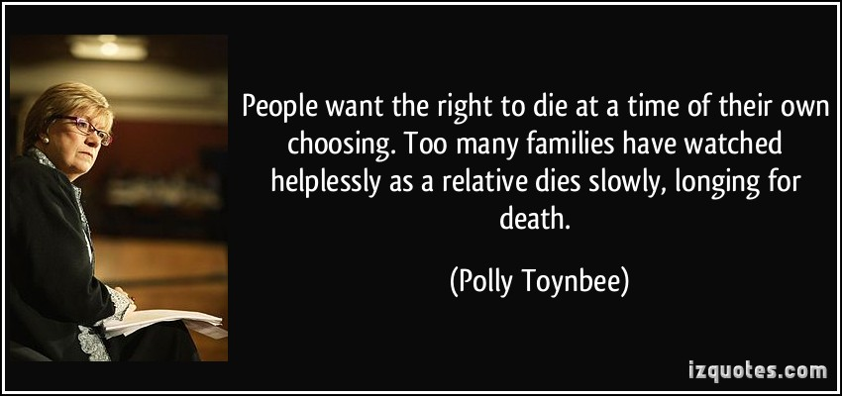
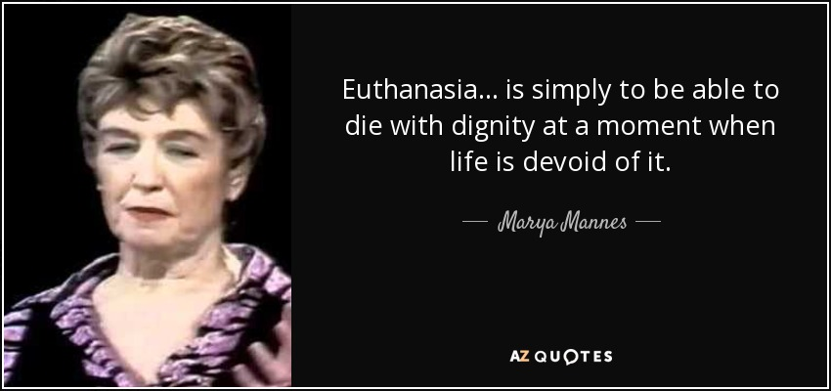
“It has given me peace. I do not want to die, but I am dying, and I want to die on my own terms.”
“It has given me peace. I do not want to die, but I am dying, and I want to die on my own terms.”
“As I battle my illness, I would like the choice and comfort that come with the option of aid in dying.”

